Slide 1
Special functions and Integral Transforms MAT 241
Dr. Mohamed Adel
mohamed.adel@aiet.edu.eg

Slide 2
LEC-6 Series Solution of DE Power Series Method

Slide 3


Outline:
Introduction.
Ordinary and Singular points.
Power Series Solution:
Technique steps.
Adding two power series.
Recurrence Relation.

Slide 4

Introduction:
Solving linear ordinary differential equation (ODE) with constant coefficient is considered as an essential problem in many fields.
But this problem was solved using algebraic methods by finding the roots of the auxiliary equation and a general solution can be written as a linear combination of the elementary functions such as, .
For linear differential equations with variable coefficients the situation is more complicated, and their solutions may be nonelementary functions.
A usual course of action for equations of this sort is to assume a solution in the form of infinite series and proceed in a manner similar to the method of undetermined coefficients.

Slide 5
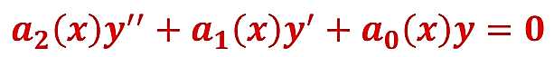
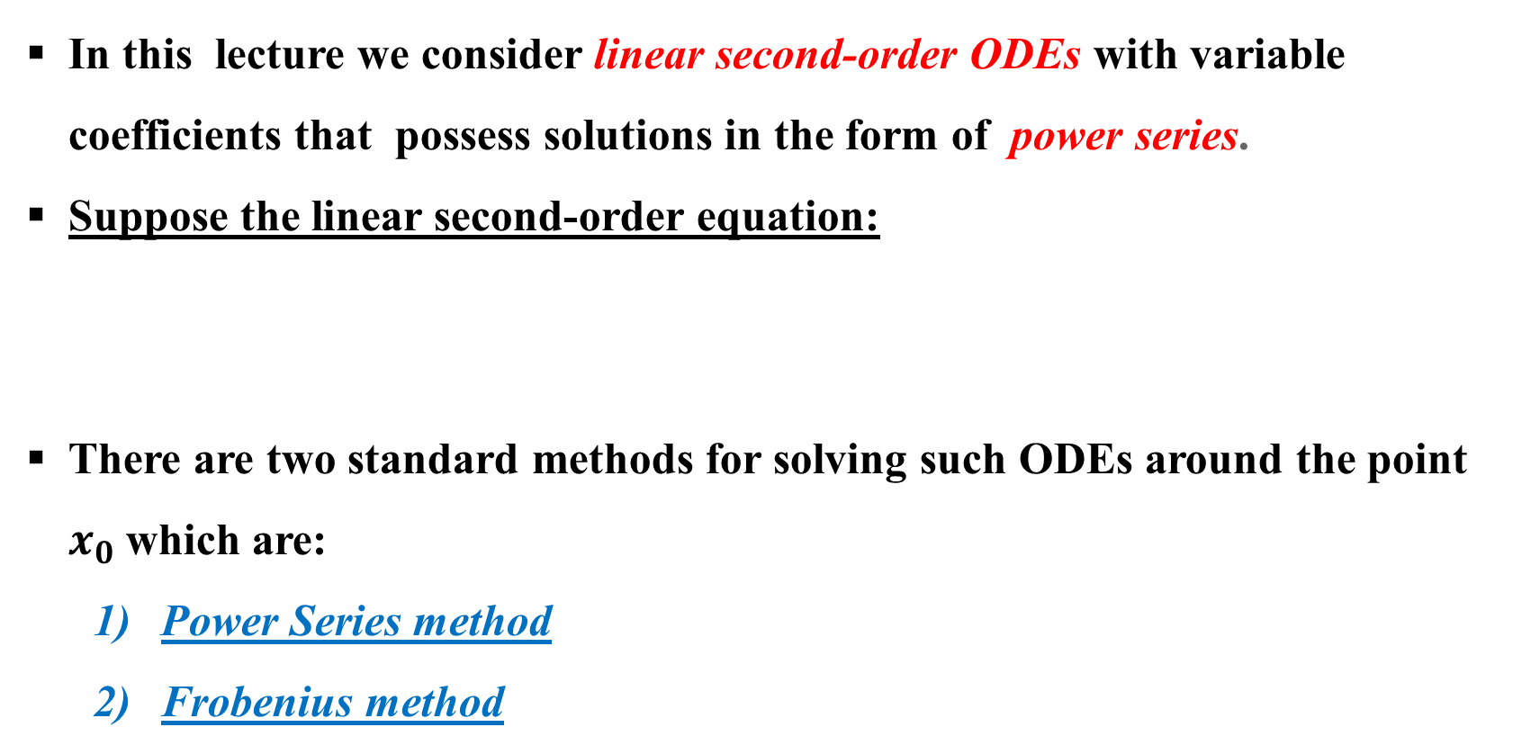
Introduction:
In this lecture we consider linear second-order ODEs with variable coefficients that possess solutions in the form of power series.
Suppose the linear second-order equation:
There are two standard methods for solving such ODEs around the point $x_{0}$which are:
Power Series method
Frobenius method

Slide 6
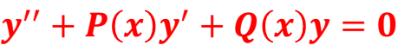
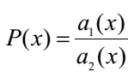
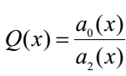
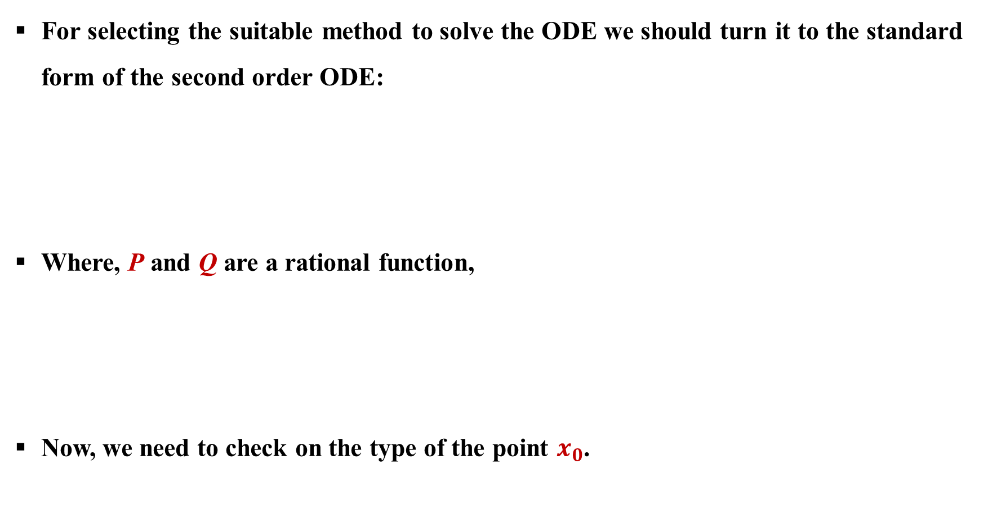
Ordinary and singular points:
For selecting the suitable method to solve the ODE we should turn it to the standard form of the second order ODE:
Where, P and Q are a rational function,
Now, we need to check on the type of the point $x_{0}$.

Slide 7
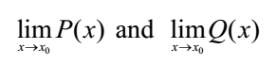
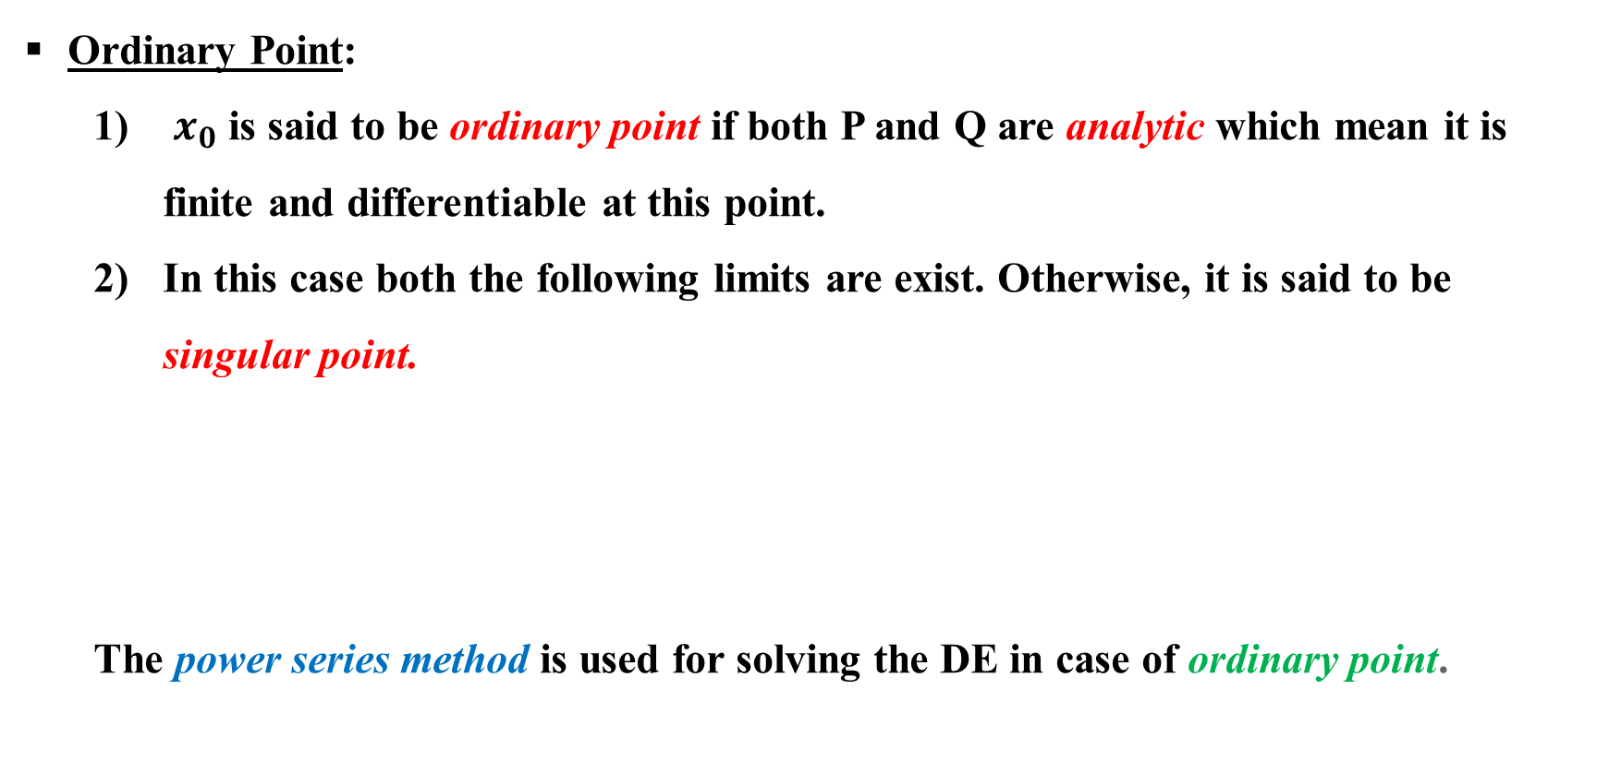
Ordinary and singular points:
Ordinary Point:
$x_{0}$ is said to be ordinary point if both P and Q are analytic which mean it is finite and differentiable at this point.
In this case both the following limits are exist. Otherwise, it is said to be singular point.
The power series method is used for solving the DE in case of ordinary point.

Slide 8
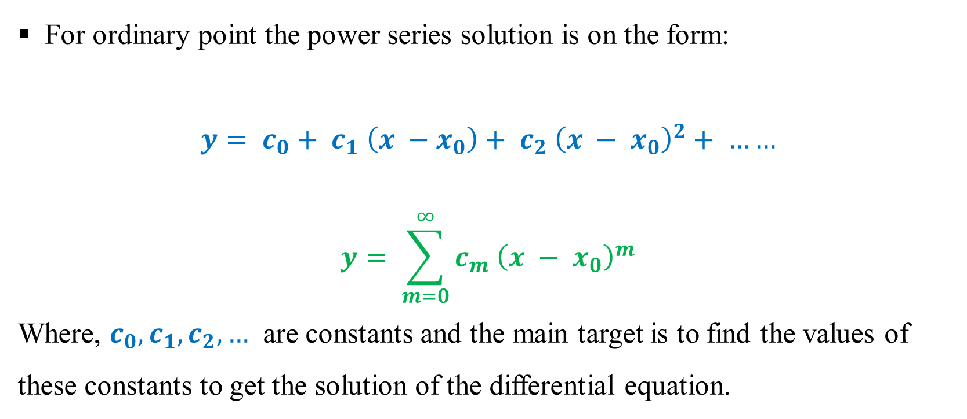
Ordinary point power series solution form
For ordinary point the power series solution is on the form:
$$y= c_{0}+ c_{1} \left(x −x_{0}\right)+ c_{2} {\left(x − x_{0}\right)}^{2}+ ……$$
$$y= \sum_{m=0}^{∞}{c_{m} {\left(x − x_{0}\right)}^{m}}$$
Where, $c_{0}, c_{1}, c_{2}, …$ are constants and the main target is to find the values of these constants to get the solution of the differential equation.

Slide 9
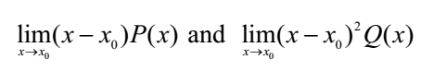
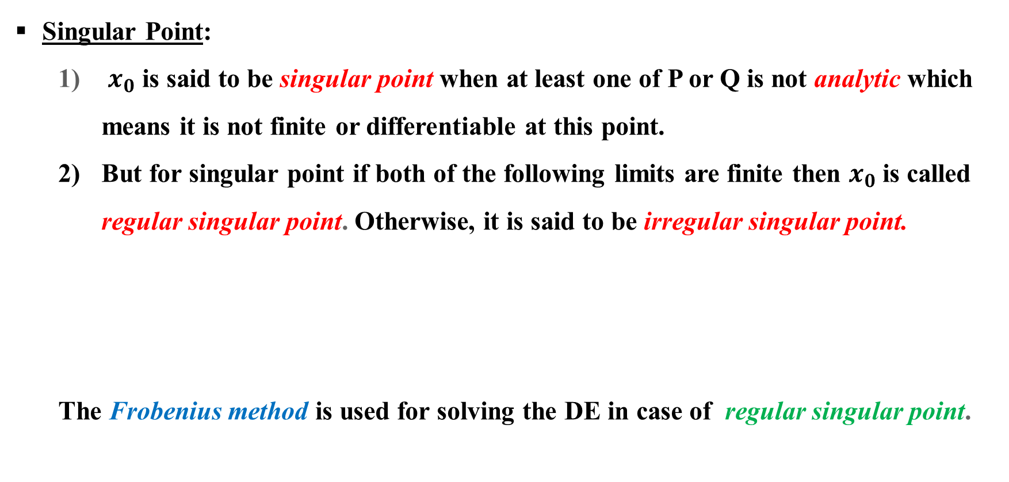
Ordinary and singular points:
Singular Point:
$x_{0}$ is said to be singular point when at least one of P or Q is not analytic which means it is not finite or differentiable at this point.
But for singular point if both of the following limits are finite then $x_{0}$ is called regular singular point. Otherwise, it is said to be irregular singular point.
The Frobenius method is used for solving the DE in case of regular singular point.

Slide 10
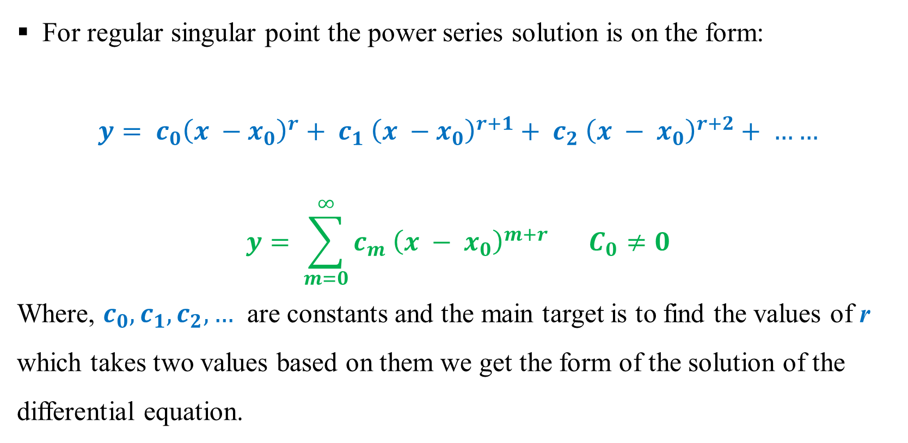
Regular singular point power series solution form
For regular singular point the power series solution is on the form:
$$y= c_{0}{\left(x −x_{0}\right)}^{r}+ c_{1} {\left(x −x_{0}\right)}^{r+1}+ c_{2} {\left(x − x_{0}\right)}^{r+2}+ ……$$
$$y= \sum_{m=0}^{∞}{c_{m} {\left(x − x_{0}\right)}^{m+r}} C_{0}≠0$$
Where, $c_{0}, c_{1}, c_{2}, …$ are constants and the main target is to find the values of r which takes two values based on them we get the form of the solution of the differential equation.

Slide 11
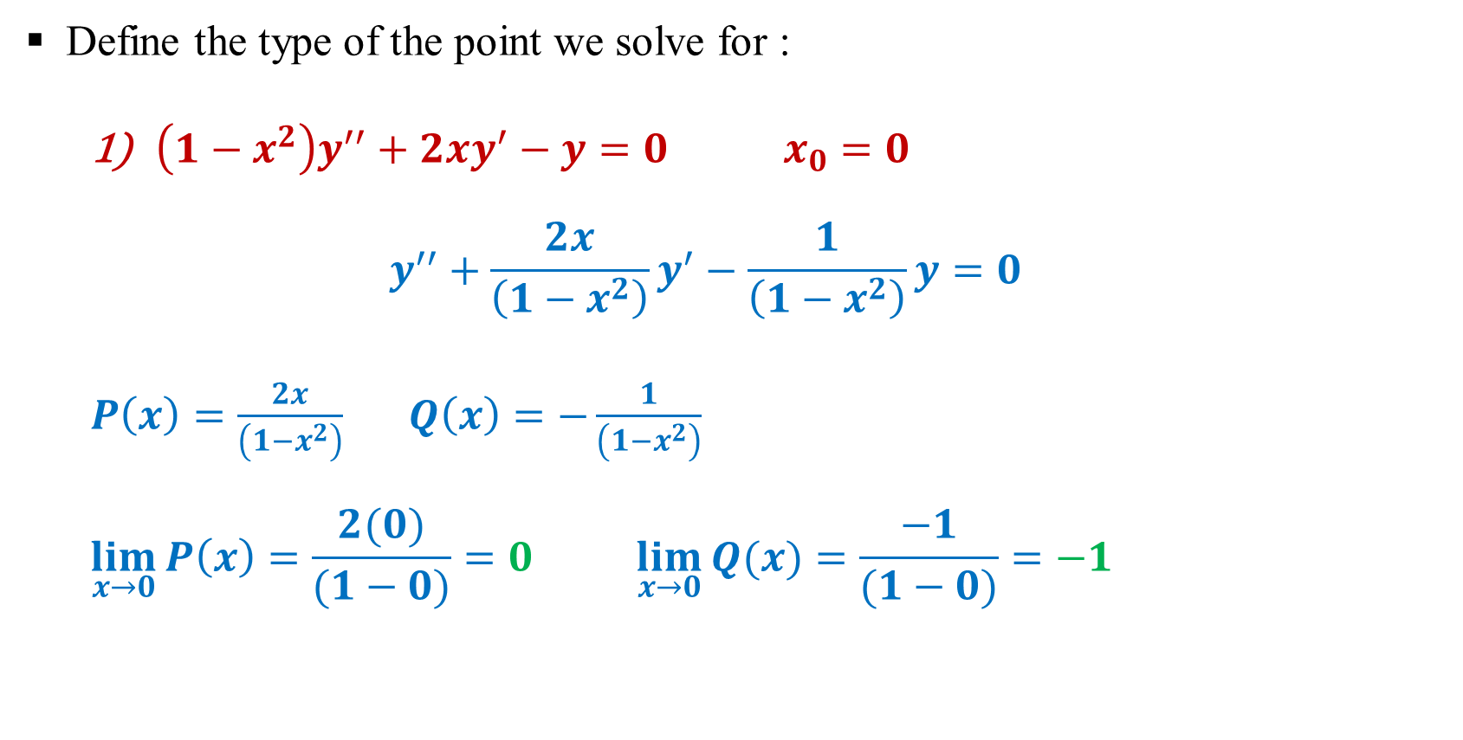
Exercise:
Define the type of the point we solve for :
$\left(1−x^{2}\right)y^{′′}+2xy^{′}−y=0 x_{0}=0$
$$y^{′′}+\frac{2x}{\left(1−x^{2}\right)}y^{′}−\frac{1}{\left(1−x^{2}\right)}y=0$$
$P\left(x\right)=\frac{2x}{\left(1−x^{2}\right)}$ $Q\left(x\right)=−\frac{1}{\left(1−x^{2}\right)}$
$$\lim_{x→0}{P\left(x\right)}=\frac{2(0)}{(1−0)}=0 \lim_{x→0}{Q(x)}=\frac{−1}{(1−0)}=−1$$
Ordinary Point

Slide 12
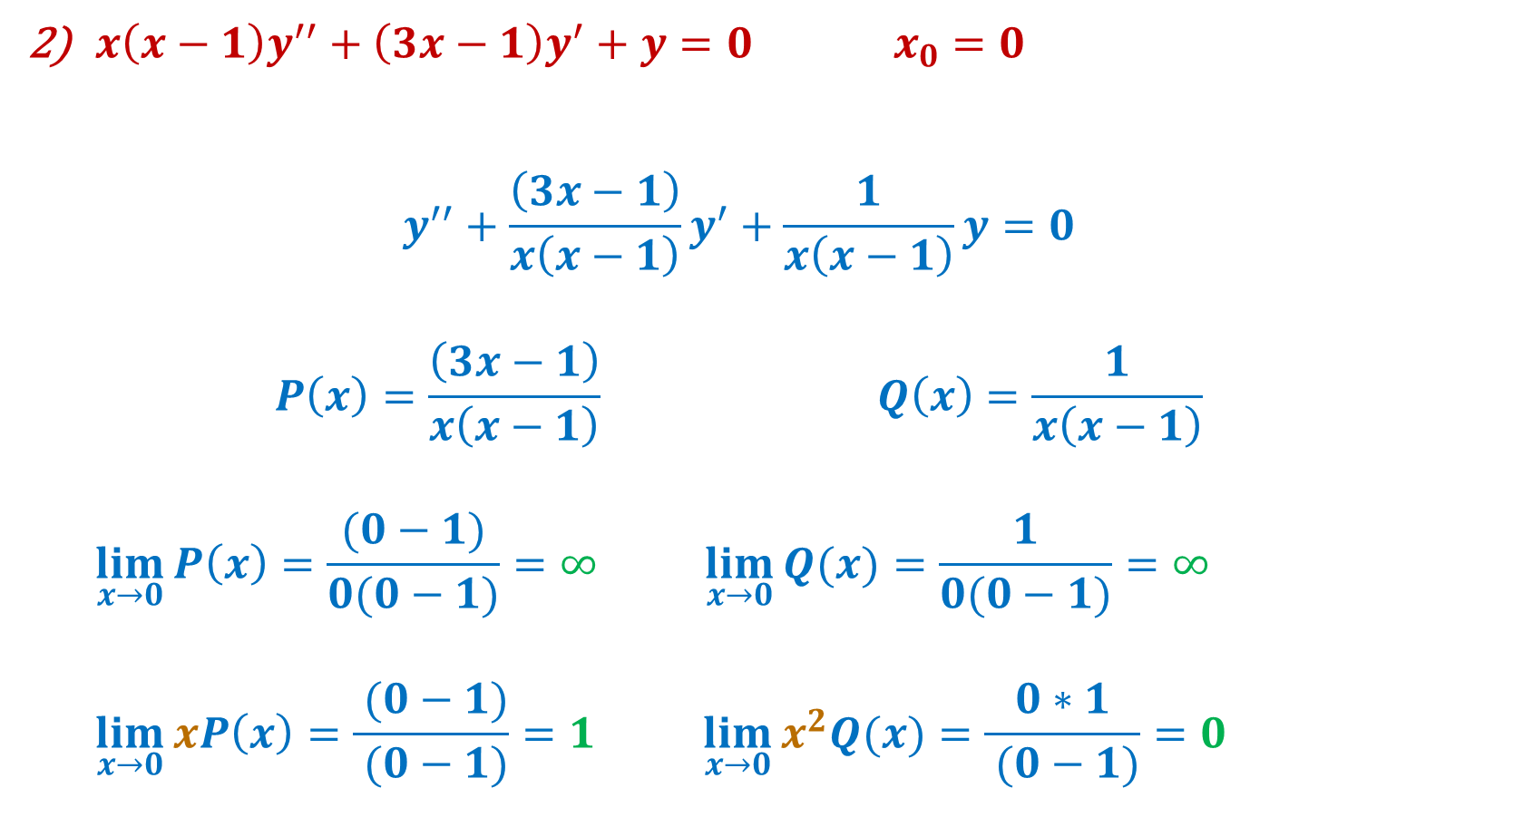
Exercise:
$x\left(x−1\right)y^{′′}+\left(3x−1\right)y^{′}+y=0 x_{0}=0$
$$y^{′′}+\frac{\left(3x−1\right)}{x\left(x−1\right)}y^{′}+\frac{1}{x\left(x−1\right)}y=0$$
$$P\left(x\right)=\frac{\left(3x−1\right)}{x\left(x−1\right)} Q\left(x\right)=\frac{1}{x\left(x−1\right)}$$
$$\lim_{x→0}{P\left(x\right)}=\frac{(0−1)}{0(0−1)}=∞ \lim_{x→0}{Q(x)}=\frac{1}{0(0−1)}=∞$$
$$\lim_{x→0}{xP\left(x\right)}=\frac{ (0−1)}{ (0−1)}=1 \lim_{x→0}{x^{2}Q(x)}=\frac{0∗1}{ (0−1)}=0$$
Regular Singular Point

Slide 13
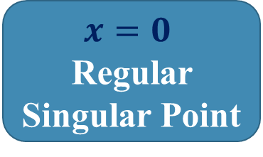
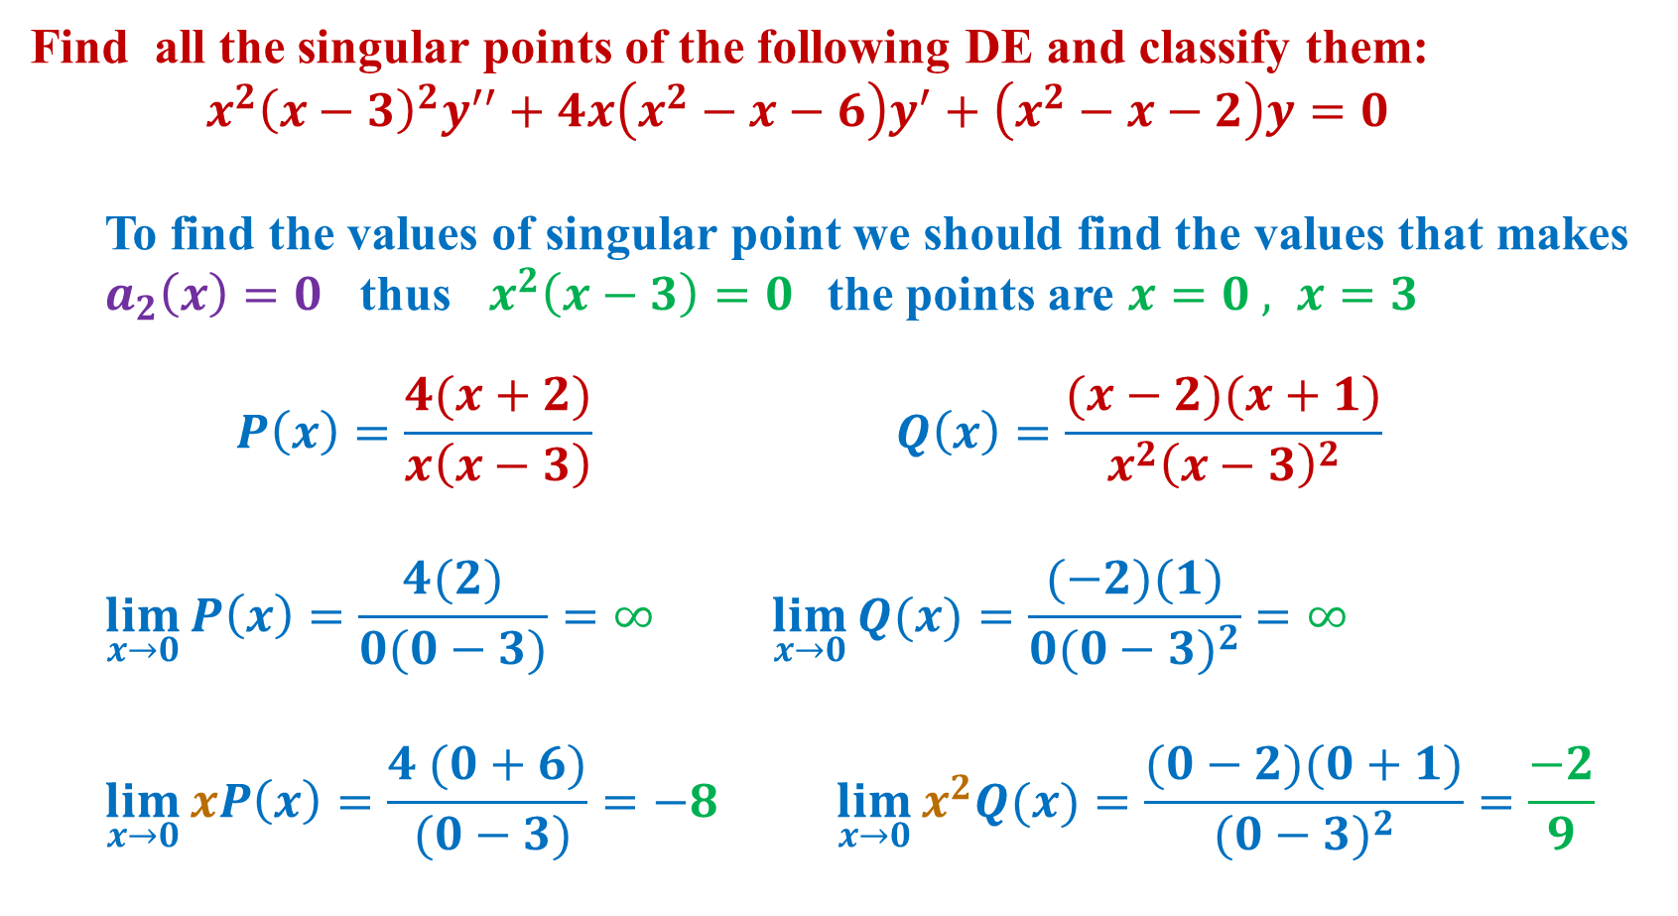
Exercise:
Find all the singular points of the following DE and classify them:
$$x^{2}{\left(x−3\right)}^{2}y^{′′}+4x\left(x^{2}−x−6\right)y^{′}+\left(x^{2}−x−2\right)y=0$$
To find the values of singular point we should find the values that makes $a_{2}\left(x\right)=0$ thus $x^{2}\left(x−3\right)=0$ the points are $x=0 , x=3$
$$P\left(x\right)=\frac{4(x+2)}{x\left(x−3\right)} Q\left(x\right)=\frac{(x−2)(x+1)}{x^{2}{\left(x−3\right)}^{2}}$$
$$\lim_{x→0}{P\left(x\right)}=\frac{4(2)}{0(0−3)}=∞ \lim_{x→0}{Q(x)}=\frac{(−2)(1)}{0{(0−3)}^{2}}=∞$$
$$\lim_{x→0}{xP\left(x\right)}=\frac{4 (0+6)}{ (0−3)}=−8 \lim_{x→0}{x^{2}Q(x)}=\frac{(0−2)(0+1)}{{(0−3)}^{2}}=\frac{−2}{9}$$
$$x=0$$
Regular Singular Point

Slide 14
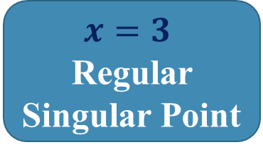
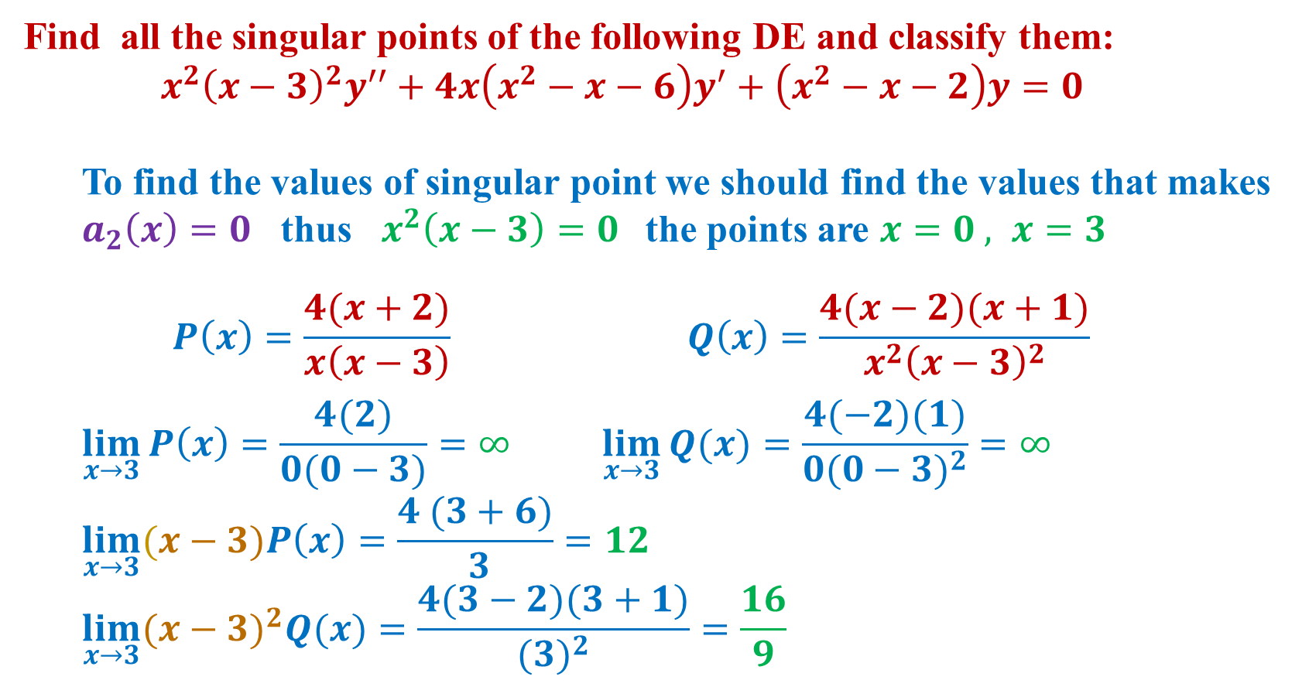
Exercise:
Find all the singular points of the following DE and classify them:
$$x^{2}{\left(x−3\right)}^{2}y^{′′}+4x\left(x^{2}−x−6\right)y^{′}+\left(x^{2}−x−2\right)y=0$$
To find the values of singular point we should find the values that makes $a_{2}\left(x\right)=0$ thus $x^{2}\left(x−3\right)=0$ the points are $x=0 , x=3$
$$P\left(x\right)=\frac{4(x+2)}{x\left(x−3\right)} Q\left(x\right)=\frac{4(x−2)(x+1)}{x^{2}{\left(x−3\right)}^{2}}$$
$$\lim_{x→3}{P\left(x\right)}=\frac{4(2)}{0(0−3)}=∞ \lim_{x→3}{Q(x)}=\frac{4(−2)(1)}{0{(0−3)}^{2}}=∞$$
$$\lim_{x→3}{(x−3)P\left(x\right)}=\frac{4 (3+6)}{ 3}=12$$
$$\lim_{x→3}{{(x−3)}^{2}Q(x)}=\frac{4(3−2)(3+1)}{{(3)}^{2}}=\frac{16}{9}$$
$$x=3$$
Regular Singular Point

Slide 15
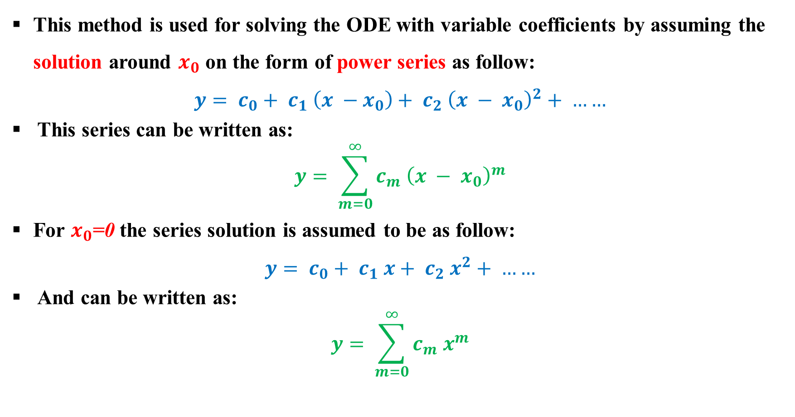
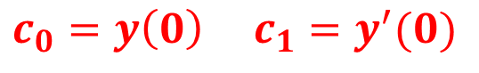
Power Series solution:
This method is used for solving the ODE with variable coefficients by assuming the solution around $x_{0}$ on the form of power series as follow:
$$y= c_{0}+ c_{1} \left(x −x_{0}\right)+ c_{2} {\left(x − x_{0}\right)}^{2}+ ……$$
This series can be written as:
$$y= \sum_{m=0}^{∞}{c_{m} {\left(x − x_{0}\right)}^{m}}$$
For $x_{0}$=0 the series solution is assumed to be as follow:
$$y= c_{0}+ c_{1} x+ c_{2} x^{2}+ ……$$
And can be written as:
$$y= \sum_{m=0}^{∞}{c_{m} x^{m}}$$
$$c_{0}=y\left(0\right) c_{1}=y^{′}(0)$$

Slide 16
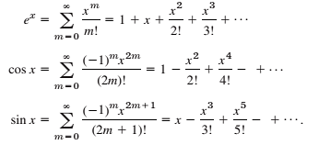
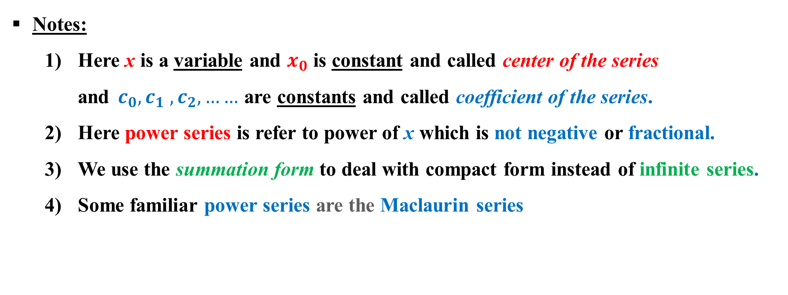
Power Series solution:
Notes:
Here x is a variable and $x_{0}$ is constant and called center of the series and$c_{0}, c_{1} , c_{2}, ……$ are constants and called coefficient of the series.
Here power series is refer to power of x which is not negative or fractional.
We use the summation form to deal with compact form instead of infinite series.
Some familiar power series are the Maclaurin series

Slide 17
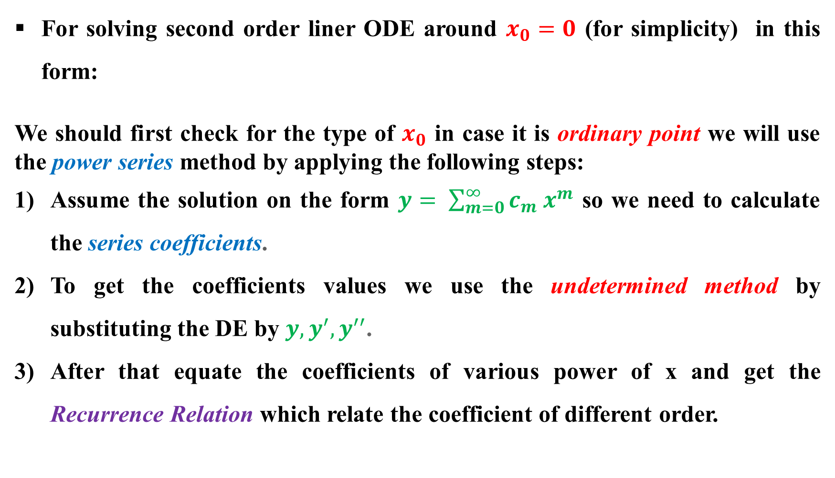
Steps of the power series method:
For solving second order liner ODE around $x_{0}=0$ (for simplicity) in this form:
We should first check for the type of $x_{0}$ in case it is ordinary point we will use the power series method by applying the following steps:
Assume the solution on the form $y= \sum_{m=0}^{∞}{c_{m} x^{m}}$ so we need to calculate the series coefficients.
To get the coefficients values we use the undetermined method by substituting the DE by $y, y^{′}, y^{′′}$.
After that equate the coefficients of various power of x and get the Recurrence Relation which relate the coefficient of different order.

Slide 18
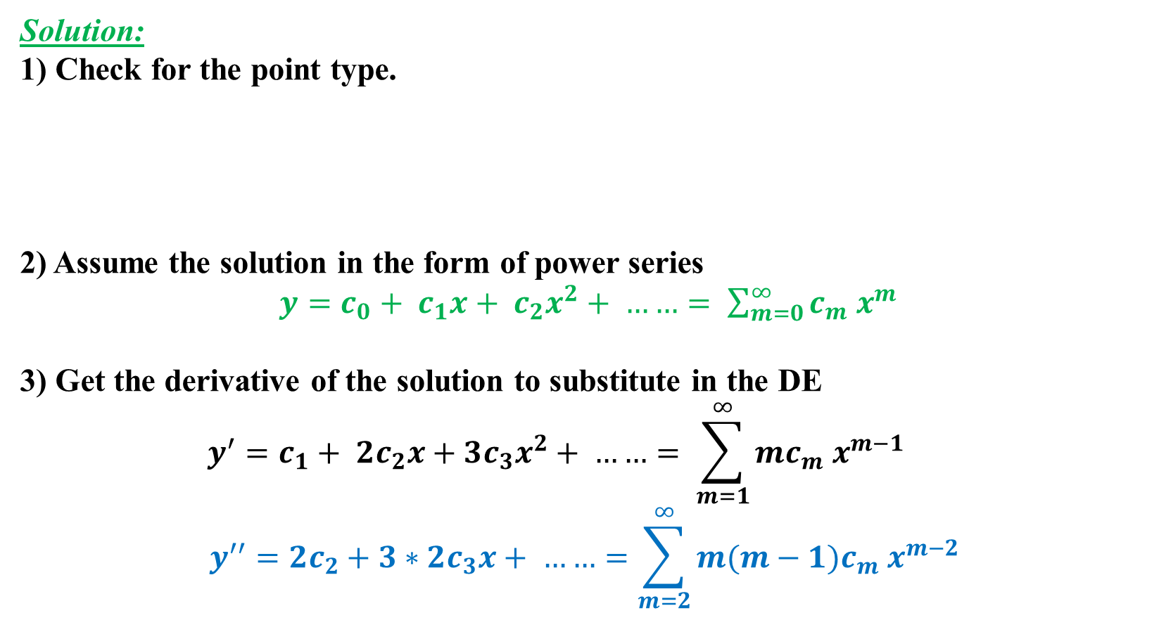
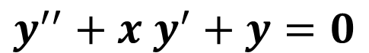
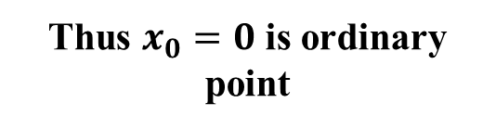
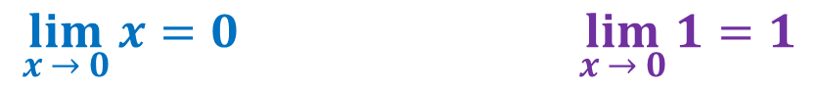
Example (1): Solve the following DE at x =0
$$y^{′′}+x y^{′}+y=0$$
Solution:
1) Check for the point type.
2) Assume the solution in the form of power series
$y=c_{0}+ c_{1}x+ c_{2}x^{2}+ ……= \sum_{m=0}^{∞}{c_{m} x^{m}}$
3) Get the derivative of the solution to substitute in the DE
$$y^{′}=c_{1}+ {2c}_{2}x+{3c}_{3}x^{2}+ ……= \sum_{m=1}^{∞}{mc_{m} x^{m−1}}$$
$$y^{′′}=2c_{2}+3∗2c_{3}x+ ……=\sum_{m=2}^{∞}{m(m−1)c_{m} x^{m−2}}$$
$$P\left(x\right)=x Q \left(x\right)=1$$
Thus $x_{0}=0$ is ordinary point
$$\lim_{x → 0}{x}=0 \lim_{x → 0}{1}=1$$

Slide 19
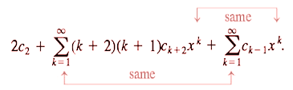
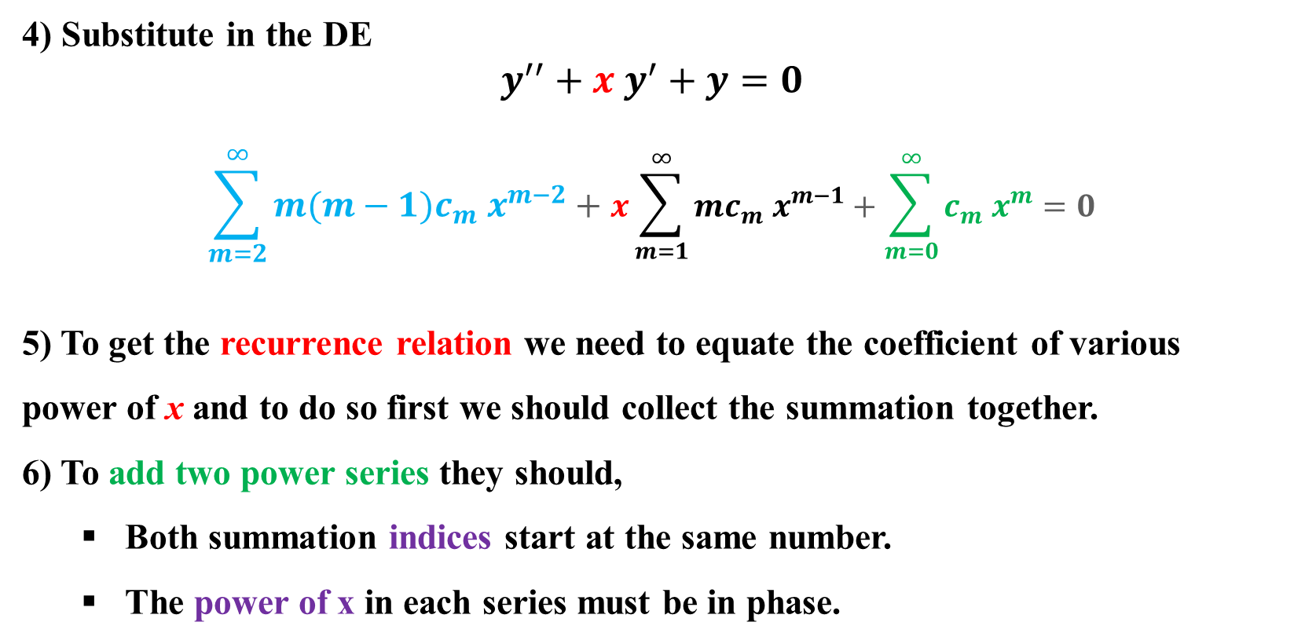
4) Substitute in the DE
$$y^{′′}+x y^{′}+y=0$$
$$\sum_{m=2}^{∞}{m(m−1)c_{m} x^{m−2}}+x\sum_{m=1}^{∞}{mc_{m} x^{m−1}}+\sum_{m=0}^{∞}{c_{m} x^{m}}=0$$
5) To get the recurrence relation we need to equate the coefficient of various power of x and to do so first we should collect the summation together.
6) To add two power series they should,
Both summation indices start at the same number.
The power of x in each series must be in phase.

Slide 20
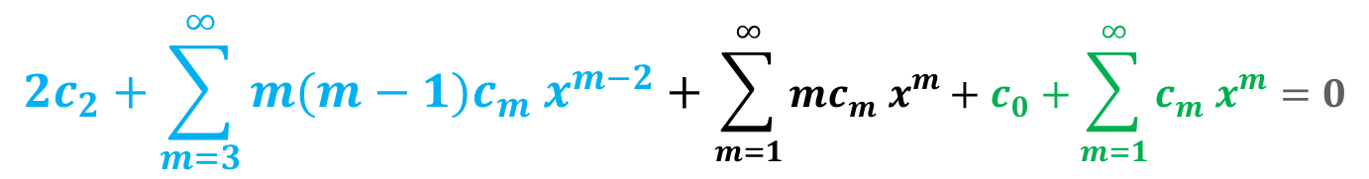
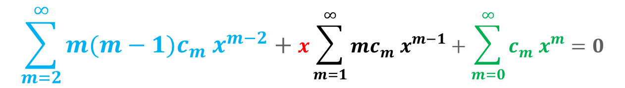
$$\sum_{m=2}^{∞}{m(m−1)c_{m} x^{m−2}}+x\sum_{m=1}^{∞}{mc_{m} x^{m−1}}+\sum_{m=0}^{∞}{c_{m} x^{m}}=0$$
$$(2c_{2}+3∗2c_{3}x+…)+x(c_{1}+ {2c}_{2}x+{3c}_{3}x^{2}+ …)+(c_{0}+ c_{1}x+ c_{2}x^{2}+ …)=0$$
$$(2c_{2}+3∗2c_{3}x+…)+ (c_{1}x+ {2c}_{2}x^{2}+{3c}_{3}x^{3}+ …)+(c_{0}+ c_{1}x+ c_{2}x^{2}+ …)=0$$
Lowest power 0
Lowest power 1
Lowest power 0
In order to make the summation have the same power we should make them all in phase with the largest lowest power which here is one.
$$2c_{2}+\sum_{m=3}^{∞}{m(m−1)c_{m} x^{m−2}}+\sum_{m=1}^{∞}{mc_{m} x^{m}}+c_{0}+\sum_{m=1}^{∞}{c_{m} x^{m}}=0$$
Now we need to set the summation indices to the same start point so we will adjust the first summation only by replacing each m by m+2.

Slide 21
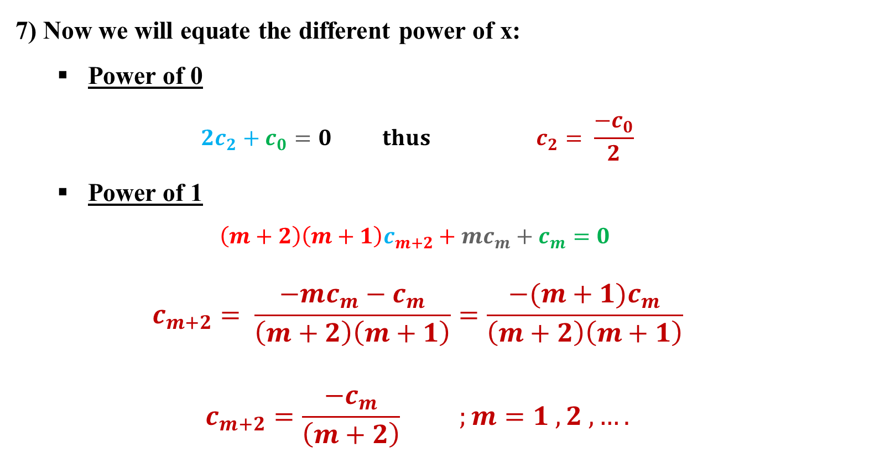
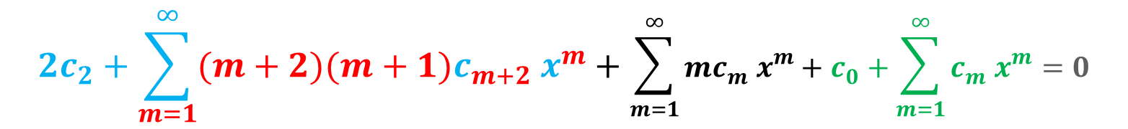
$$2c_{2}+\sum_{m=1}^{∞}{(m+2)(m+1)c_{m+2} x^{m}}+\sum_{m=1}^{∞}{mc_{m} x^{m}}+c_{0}+\sum_{m=1}^{∞}{c_{m} x^{m}}=0$$
7) Now we will equate the different power of x:
Power of 0
$$2c_{2}+c_{0}=0 thus c_{2}= \frac{{−c}_{0}}{2}$$
Power of 1
$$\left(m+2\right)\left(m+1\right)c_{m+2}+mc_{m}+c_{m}=0$$
$$c_{m+2}= \frac{−mc_{m}−c_{m}}{\left(m+2\right)\left(m+1\right)}=\frac{−(m+1)c_{m}}{\left(m+2\right)\left(m+1\right)}$$
$$c_{m+2}=\frac{−c_{m}}{\left(m+2\right)} ;m=1 ,2 , ….$$

Slide 22
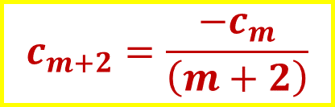
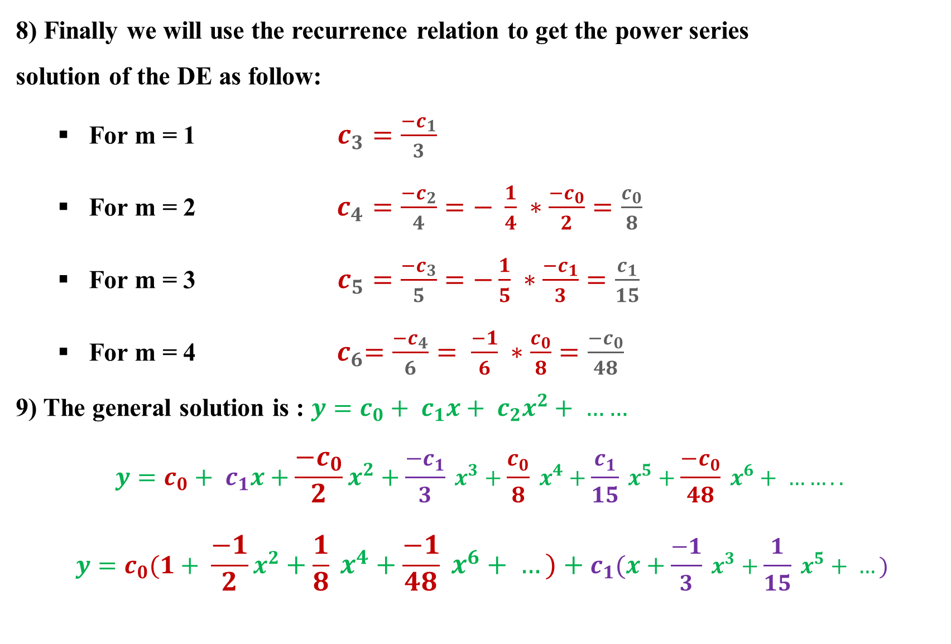
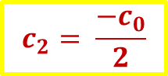
8) Finally we will use the recurrence relation to get the power series
solution of the DE as follow:
For m = 1 $c_{3}=\frac{−c_{1}}{3}$
For m = 2 $c_{4}=\frac{−c_{2}}{4}=− \frac{1}{4} ∗\frac{−c_{0}}{2}=\frac{c_{0}}{8}$
For m = 3 $c_{5}=\frac{−c_{3}}{5}=−\frac{1}{5} ∗\frac{−c_{1}}{3}=\frac{c_{1}}{15}$
For m = 4 ${ c}_{6}=\frac{−c_{4}}{6}= \frac{−1}{6} ∗\frac{c_{0}}{8}=\frac{{−c}_{0}}{48}$
9) The general solution is : $y=c_{0}+ c_{1}x+ c_{2}x^{2}+ ……$
$$y=c_{0}+ c_{1}x+\frac{−c_{0}}{2}x^{2}+\frac{−c_{1}}{3} x^{3}+\frac{c_{0}}{8} x^{4}+\frac{c_{1}}{15} x^{5}+\frac{{−c}_{0}}{48} x^{6}+ ……..$$
$$y=c_{0}(1+ \frac{−1}{2}x^{2}+\frac{1}{8} x^{4}+\frac{−1}{48} x^{6}+ …)+c_{1}(x+\frac{−1}{3} x^{3}+\frac{1}{15} x^{5}+ …)$$
$$c_{m+2}=\frac{−c_{m}}{\left(m+2\right)}$$
$$c_{2}= \frac{−c_{0}}{2}$$

